Slide 1
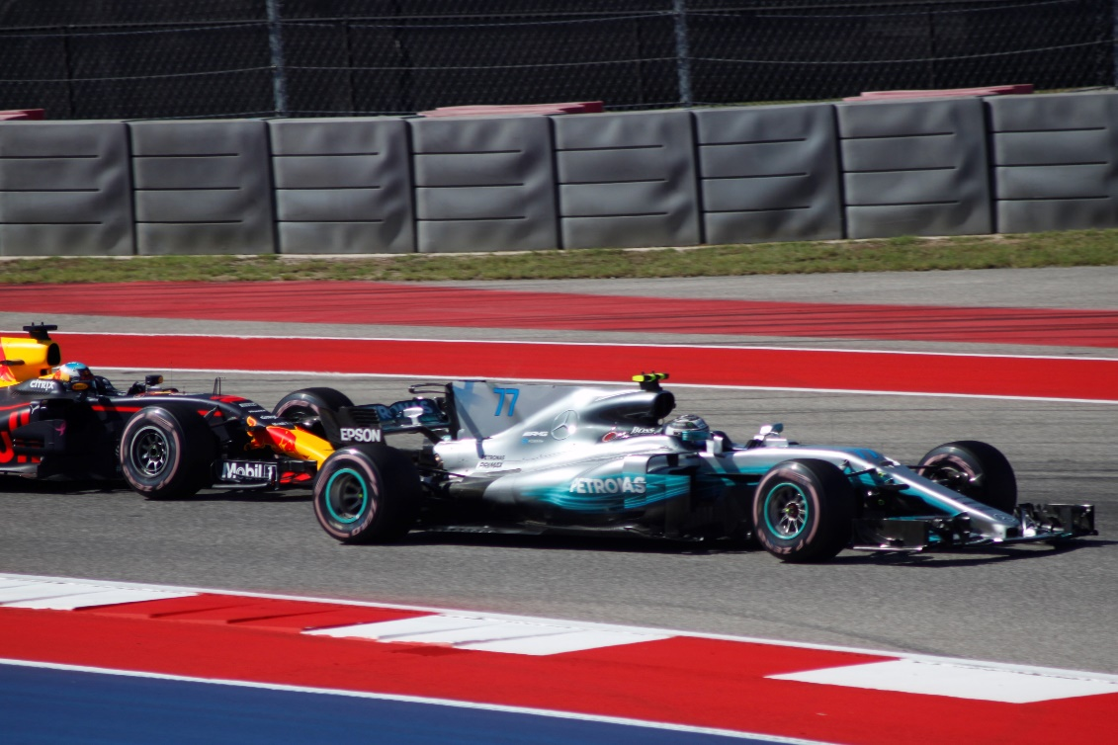
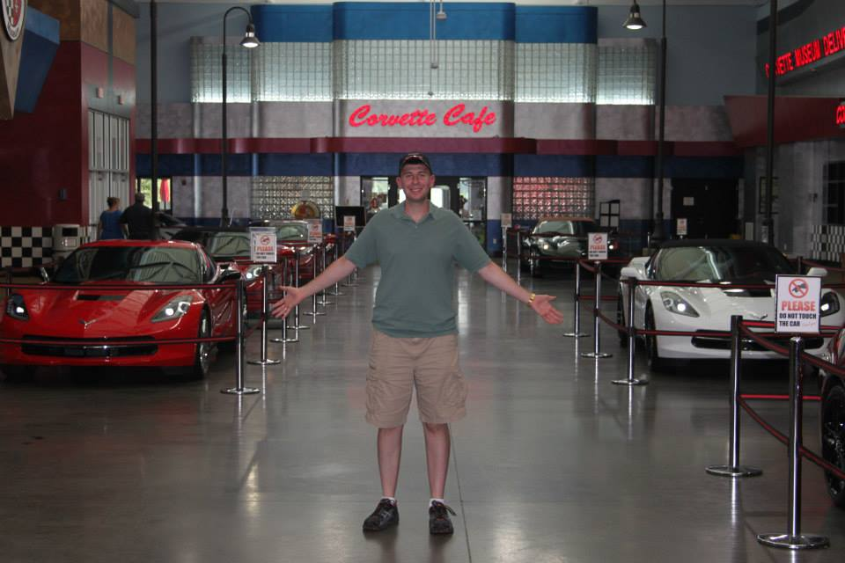
Kinetics Intro Review (it’s all about speed)
11/12/18
Geoff Geberth

Slide 2
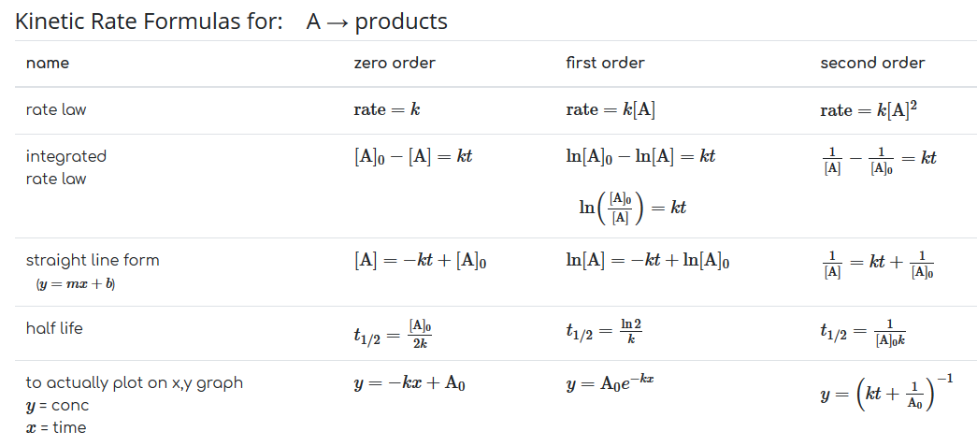

Slide 3
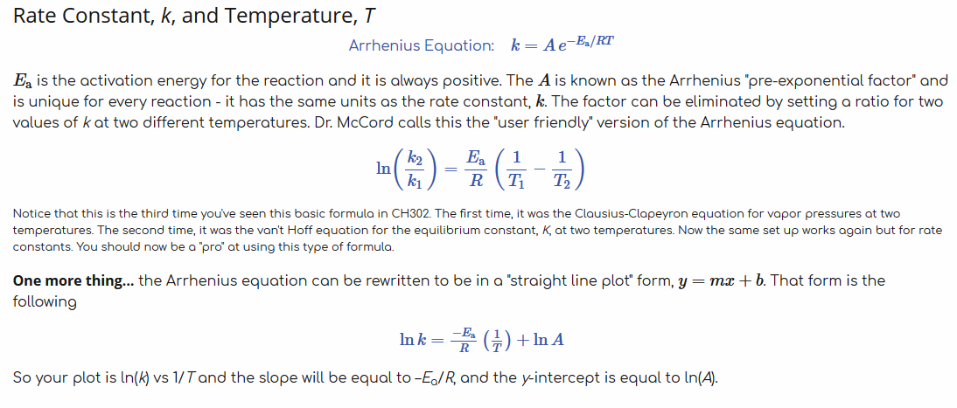

Slide 4
Why do we care about kinetics?
Thermodynamics tells us what can happen and what states are lower in overall energy
Kinetics tells us what is actually and currently happening and on what time scales
Example: Graphite is lower in free energy than diamond, but kinetics is preventing conversion of diamond to graphite on a realistic time scale

Slide 5
Definitions
Kinetics-studying how fast a reaction is occurring (the rate)
Equilibrium (Kinetic definition)
Forward and backwards rates are the same
Rate law
Means of relating the rate of a reaction to the concentrations of the reactants

Slide 6
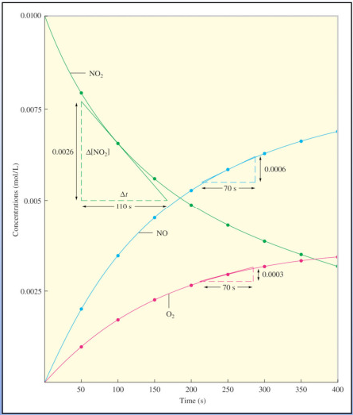
Reaction rates
Change in concentration of a reactant with respect to time
Reactants can be changing at different rates depending on the stoichiometry of the reaction
If we know one rate, we know them all from the balanced equation!

Slide 7
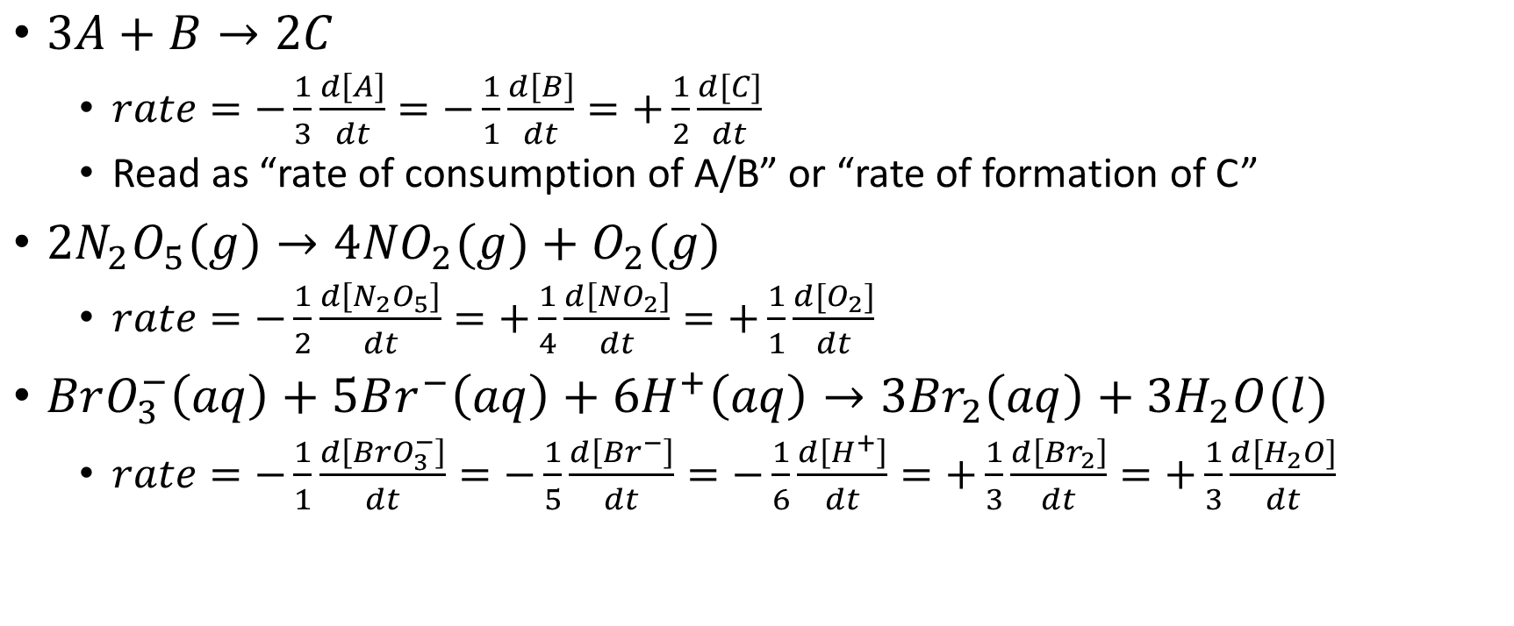
Some examples
$3A+B→2C$
$rate=−\frac{1}{3}\frac{d\left[A\right]}{dt}=−\frac{1}{1}\frac{d\left[B\right]}{dt}=+\frac{1}{2}\frac{d[C]}{dt}$
Read as “rate of consumption of A/B” or “rate of formation of C”
$2N_{2}O_{5}(g)→4{NO}_{2}(g)+O_{2}(g)$
$rate=−\frac{1}{2}\frac{d\left[N_{2}O_{5}\right]}{dt}=+\frac{1}{4}\frac{d\left[{NO}_{2}\right]}{dt}=+\frac{1}{1}\frac{d[O_{2}]}{dt}$
$BrO_{3}^{−}\left(aq\right)+5Br^{−}\left(aq\right)+6H^{+}\left(aq\right)→3{Br}_{2}\left(aq\right)+3H_{2}O(l)$
$rate=−\frac{1}{1}\frac{d\left[{BrO}_{3}^{−}\right]}{dt}=−\frac{1}{5}\frac{d\left[{Br}^{−}\right]}{dt}=−\frac{1}{6}\frac{d\left[H^{+}\right]}{dt}=+\frac{1}{3}\frac{d\left[{Br}_{2}\right]}{dt}=+\frac{1}{3}\frac{d[H_{2}O]}{dt}$

Slide 8
$$2N_{2}O_{5}(g)→4{NO}_{2}(g)+O_{2}(g)$$
$rate=−\frac{1}{2}\frac{d\left[N_{2}O_{5}\right]}{dt}=+\frac{1}{4}\frac{d\left[{NO}_{2}\right]}{dt}=+\frac{1}{1}\frac{d[O_{2}]}{dt}$
Using these we can compare the different rates for different participants
Examples:
NO2 forms 4 times faster than O2 (O2 forms ¼ as fast as NO2)
NO2 forms twice as fast as N2O5 is consumed
O2 forms half as fast as N2O5 is consumed

Slide 9
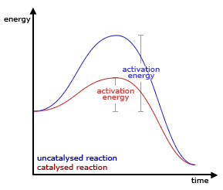
Factors affecting rates
Medium or nature of the reactants
The physical state; is it a clump or a disperse powder?
Concentration
Temperature
Energy is required to break bonds before new bonds can be formed
All elementary reactions have a faster rate at higher temperature
Catalyst
Lowers the energy barrier

Slide 10
Rate laws
YOU CANNOT DETERMINE A RATE LAW JUST FROM LOOKING AT A REACTION! YOU MUST FIND THESE EXPERIMENTALLY!
$rate=k{\left[A\right]}^{X}{\left[B\right]}^{Y}$
Rate changes with time as reactants are consumed, so rates are usually measured at the beginning of the experiment
Change the initial concentrations and we can see what concentrations affect the rate and in what way
Algebraically solve for k using data

Slide 11
Order
Easy way to communicate the impacts of different reactants
$rate=k{\left[A\right]}^{X}{\left[B\right]}^{Y}$
Xth order in A
Yth order in B
(X+Y)th order overall
0th order is a possibility
This is a situation where initial concentrations don’t influence the rate at all

Slide 12
Let’s practice
$rate=k\left[H_{2}O_{2}\right]\left[K\right]$
First order in hydrogen peroxide, first order in potassium, second order overall
$rate=k{\left[CH{Cl}_{3}\right]}^{5}{\left[SO_{4}^{2−}\right]}^{2}$
Fifth order in CHCl3, second order in sulfate, seventh order overall
$rate=k$
0th order in any reactants, and 0th order overall

Slide 13
k
Your units on k change depending on the order!
The units for rate are M/s
The rate constant units change accordingly in order to maintain these units
Let’s look at that last slide again

Slide 14
Find the units of k
$rate=k\left[H_{2}O_{2}\right]\left[K\right]$
First order in hydrogen peroxide, first order in potassium, second order overall
$k=\frac{1}{M∗s}$
$rate=k{\left[CH{Cl}_{3}\right]}^{5}{\left[SO_{4}^{2−}\right]}^{2}$
Fifth order in CHCl3, second order in sulfate, seventh order overall
$k=\frac{1}{M^{6}∗s}$
$rate=k$
0th order in any reactants, and 0th order overall
$k=\frac{M}{s}$

Slide 15
Take home messages
Kinetics is important and tells us how fast
Equilibrium is defined kinetically as the forward rate being equal to the reverse rate
Stoichiometry lets us relate the relative rates of formation/consumption, but does NOT give us a rate law
Rate laws and order must be determined experimentally
Order is determined by counting
Units of k change to keep the units of ‘rate’ in M/s

